Slide 1
Welcome to Psy 652 Lab! Module 4: Statistical Power

Slide 2
Objectives
Explain statistical power
Learn to calculate sample sizes from power & effect sizes via:
Murphy, Myors & Wolach (2014) Appendix E
G*Power
We will NOT be using R today!
(But you can do power calculations in R using the “pwr” package)

Slide 3
What is statistical power?
Power = The probability of finding an effect (Assuming there is an effect) from our sample.
So, a power of .80 means that we have an 80% chance of detecting the effect in our sample given the effect is there.
In general, we desire to have a power level of .80 or better. Anything under .80 is generally considered insufficiently powered.
We often use power a-priori to determine what a sufficient sample size will be. If you are applying for a grant, you will likely need a power analysis!
To determine sample size, we need 3 things:
An alpha value (α) – The probability of getting a type I error (Usually set α = .05 in psychology)
An effect size (Determined through the literature – Meta analyses!)
A desired power (1 - β) level (Usually set to .80)

Slide 4
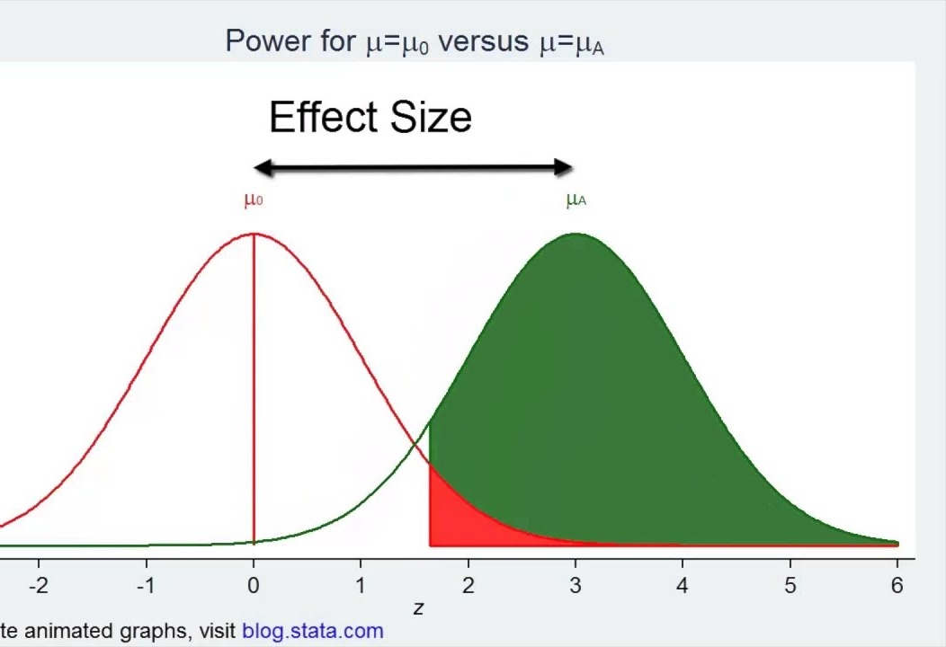
What is an effect size?
Effect size = The standardized difference between your groups or the proportion of variance explained.
There are many type of effect sizes (Cohen’s-d, PV, Odds ratios, R² etc.)
In this lesson, we will use PV and Cohen’s-d

Slide 5
Effect size, α, sample size, study complexity, and power: A relationship
As effect size increases, so does power
As α increases, so does power
Consequence: You increase the chance of making a type I error
A type I error is the chance to say an effect exists, when it does not exist
As sample size increases, so does power
As study complexity increases, power decreases
For example: All else equal, a study with 4 comparison groups will have less power than a study with 3 comparison groups

Slide 6
Today we will be covering two methods to calculate sample sizes
Murphy, Myors & Wolach (2014) Appendix E (Available in Canvas)
G*Power (A downloadable power calculator program for Mac & Windows)
https://www.psychologie.hhu.de/arbeitsgruppen/allgemeine-psychologie-und-arbeitspsychologie/gpower.html

Slide 7
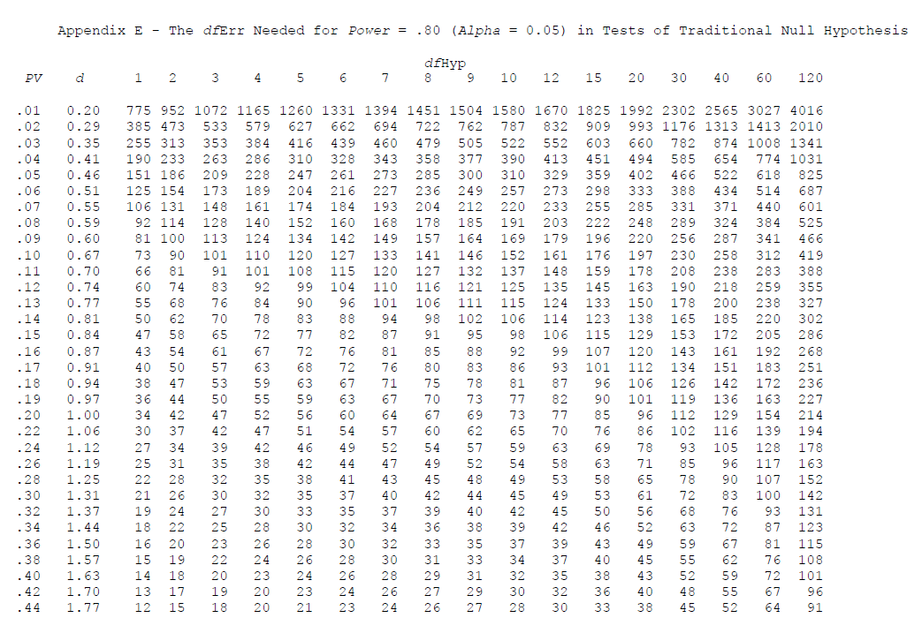
Method 1: Murphy, Myors & Wolach (2014) Appendix E

Slide 8
Method 1: Murphy, Myors & Wolach (2014) Appendix E
This table assumes you set an alpha value at .05 & a Power of .80

Slide 9
Red = df_{Hyp} Orange = Effect size (d or PV) Green = df_{Err} *Terms defined on next slide

Slide 10
Term definitions
df_{hyp}: Is an index of the complexity of the problem. For example, when comparing the 2 groups, df_{hyp} = 1. When comparing 5 groups, df_{hyp} = 4. If you are evaluating 7 predictors of an outcome, your df_{hyp} = 6.
Effect size: The proportion of variance explained (PV of .20 = 20% of the variance explained) or the standardized difference between groups (d of .20 = there are .20 standard deviations between the groups).
df_{err}: The degrees of freedom for the estimate of error used in the test.
Sample size: N = df_{hyp} + df_{err} + 1

Slide 11
Term definitions
df_{hyp}: Is an index of the complexity of the problem. For example, when comparing the 2 groups, df_{hyp} = 1. When comparing 5 groups, df_{hyp} = 4. If you are evaluating 7 predictors of an outcome, your df_{hyp} = 6.
Effect size: The proportion of variance explained (PV of .20 = 20% of the variance explained) or the standardized difference between groups (d of .20 = there are .20 standard deviations between the groups).
df_{err}: The degrees of freedom for the estimate of error used in the test.
Sample size: N = df_{hyp} + df_{err} + 1
THE END PRODUCT!

Slide 12
How to use Appendix E to get sample size
Identify your df_{Hyp}
The number or groups (or predictors) minus 1 (groups – 1)
Determine your effect size
Normally found in the literature via meta analyses
Determine the df_{Err} using your df_{Hyp} and effect size
Calculate the sample size
N = df_{hyp} + df_{err} + 1

Slide 13
An example
You are conducting a study that has 2 groups in it (an experimental and control group). A meta analytic review has recently shown that the effect size is shown to be PV = .10. How many participants are needed to reach a desired power of .80 with an alpha of .05?

Slide 14
An example
You are conducting a study that has 2 groups in it (an experimental and control group). A meta analytic review has recently shown that the effect size is shown to be PV = .10. How many participants are needed to reach a desired power of .80 with an alpha of .05?
df_{Hyp} = Groups -1 = 2 - 1 = 1
PV = .10
Next step: Find the df_{Err}

Slide 15
Finding the df_{Err}
df_{Err} = 73
Sample Size: df_{hyp} + df_{Err} +1
1 + 73 + 1 = 75
We need 75 participants to reach a power of .80

Slide 16
Another example
You are running an observational study, For your analyses, you plan to use 7 variables to predict one outcome. Your advisor tell you the general effect size for the predictor of interest and outcome is PV = .23. How many participants are needed to reach a power of .80 with an alpha of .05?

Slide 17
Another example
You are running an observational study, For your analyses, you plan to you plan to use 7 variables to predict one outcome. Your advisor tell you the general effect size for the predictor of interest and outcome is PV = .23. How many participants are needed to reach a power of .80 with an alpha of .05?
df_{Hyp} = predictors -1 = 7 - 1 = 6
PV = .23
Next step: Find the df_{Err}

Slide 18
Finding the df_{Err}
df_{Err} = 54
Sample Size: df_{hyp} + df_{Err} +1
6 + 54 + 1 = 61
We need 61 participants to reach a power of .80

Slide 19
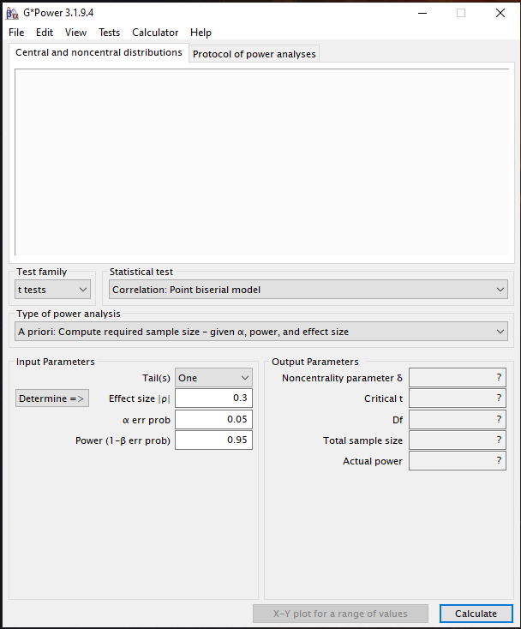

Method 2: G*Power

Slide 20
G*Power
Great Power calculator
Allows you to Calculate sample size (Given power, α, and effect size)
You can also calculate the power of a study (sample size, α, and effect size)
…And more!

Slide 21
A-priori vs post-hoc power analysis
A-priori = When you run the power analysis BEFORE you run the study to determine the sample size.
Post-hoc = When you run the power analysis AFTER you run the study to determine how much power the study had.
A-priori is preferred, but sometimes we find ourselves in situations where the only option we have is a post-hoc analysis.

Slide 22
The G*Power Calculator
Statistical Model
Type of analysis (a-priori or post-hoc… and more!)
Inputs
Outputs

Slide 23
An a-priori example (t-test)
Your planned study is a randomized control treatment assessing the mean differences of sexual knowledge scores between participants that took a 12-week sexual education class vs. those in a control group (No class). An independent samples t-test will be used to assess this difference. You want to use an alpha level of .05 and a recent meta-analysis that came out has shown that sexual education classes show an effect size of 0.12. What sample size would be needed to achieve a power level of .80?

Slide 24
An a-priori example (t-test)
Your planned study is a randomized control treatment assessing the mean differences of sexual knowledge scores between participants that took a 12-week sexual education class vs. those in a control group (No class). An independent samples t-test will be used to assess this difference. You want to use an alpha level of .05 and a recent meta-analysis that came out has shown that sexual education classes show an effect size of 0.12. What sample size would be needed to achieve a power level of .80?

Slide 25
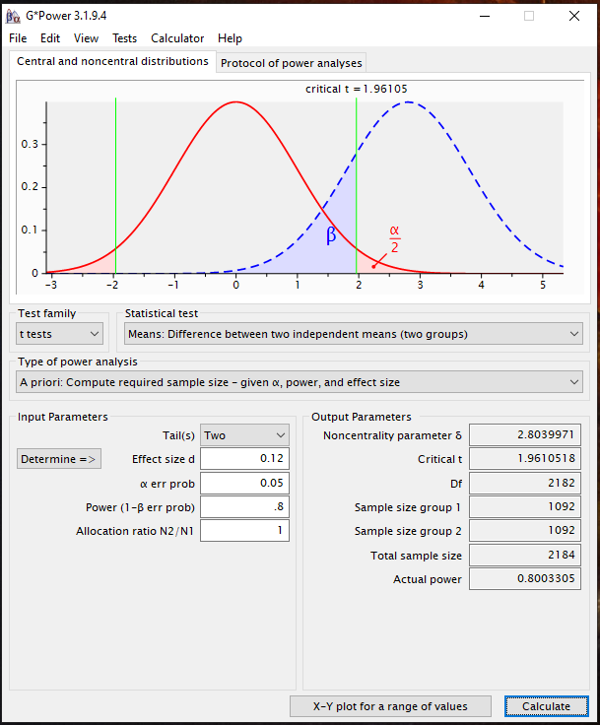
An a-priori example (t-test)
Tails = Two (Because we never indicated a direction of effect)
Effect size = .12
α = .05
Power = .8
Allocation ratio = 1 (Change this only if you suspect your group sizes will be different)

Slide 26
An a-priori example (t-test)
Total sample size needed = 2184 for a desired power of .80!

Slide 27
Another a-priori example (Omnibus ANOVA)
You are focused creating study with 3 groups trying to see if different yoga interventions have any effect on eating habits in college students. The plan is to conduct a one-way ANOVA. Generally, the expected effect size for interventions like these on eating habits is 0.15. Using an alpha value of .05, what sample size would be needed to obtain a power of .80?

Slide 28
Another a-priori example (Omnibus ANOVA)
You are focused creating study with 3 groups trying to see if different yoga interventions have any effect on eating habits on college students. The plan is to conduct a one-way ANOVA. Generally, the expected effect size for interventions like these on eating habits is 0.15. Using an alpha value of .05, what sample size would be needed to obtain a power of .80?

Slide 29
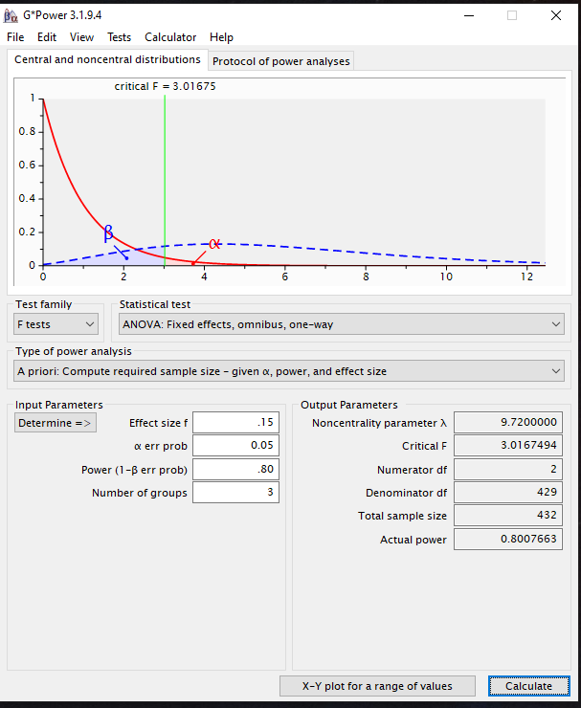
Another a-priori example (Omnibus ANOVA)
Effect size = .15
α = .05
Power = .80
Number of groups = 3

Slide 30
Another a-priori example (Omnibus ANOVA)
Total sample size needed = 432 for a desired power of .80!

Slide 31
A post-hoc example (t-test)
You recently ran an experimental study and failed to find significance between the control and treatment group when alpha was set at .01. The completed study yielded an effect size of .25 between the two groups. You used an independent samples t-test. Your sample had 200 participants in each group (400 in total). What was the power of your study?

Slide 32
A post-hoc example (t-test)
You recently ran an experimental study and failed to find significance between the control and treatment group when alpha was set at .01. The completed study yielded an effect size of .25 between the two groups. You used an independent samples t-test. Your sample had 200 participants in each group (400 in total). What was the power of your study?

Slide 33
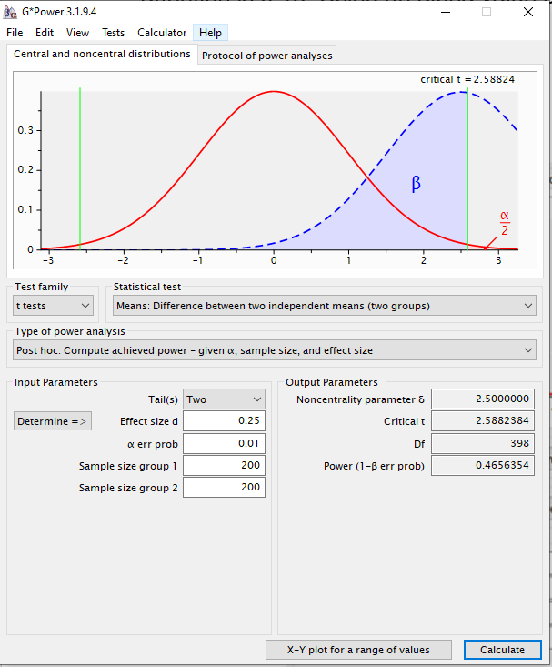
A post-hoc example (t-test)
Tails = Two (Because we never indicated a direction of effect)
Effect size = .25
α = .01
Sample size (1 & 2) = 200 in each group

Slide 34
A post-hoc example (t-test)
Your study had power of .465, meaning you only had a 46.5% chance of detecting the effect.
This was extremely underpowered!

Slide 35
A post-hoc example (Omnibus ANOVA)
Your friend conducted a study to compare the impact of 5 different yoga workouts. They recruited a sample of 250 undergraduate students. 50 participants were each assigned to one of the workouts (each participant only did one of the workouts) and they were asked to self-rate their mood after the work out. After your friend collected all of the data, they conducted a one-way ANOVA to compare the mean mood rating across the five types of yoga workouts. At a significance threshold of alpha = .05, the results were non-significant. Previous literature indicates that the effect size for the mean difference across the food groups should be around f = 0.1. Was their study sufficiently powered to detect an effect of f = 0.1, if it exists, across the four groups?

Slide 36
A post-hoc example (Omnibus ANOVA)
Your friend conducted a study to compare the impact of 5 different yoga workouts. They recruited a sample of 250 undergraduate students. 50 participants were each assigned to one of the workouts (each participant only did one of the workouts) and they were asked to self-rate their mood after the work out. After your friend collected all of the data, they conducted a one-way ANOVA to compare the mean mood rating across the five types of yoga workouts. At a significance threshold of alpha = .05, the results were non-significant. Previous literature indicates that the effect size for the mean difference across the food groups should be around f = 0.1. Was their study sufficiently powered to detect an effect of f = 0.1, if it exists, across the four groups?

Slide 37
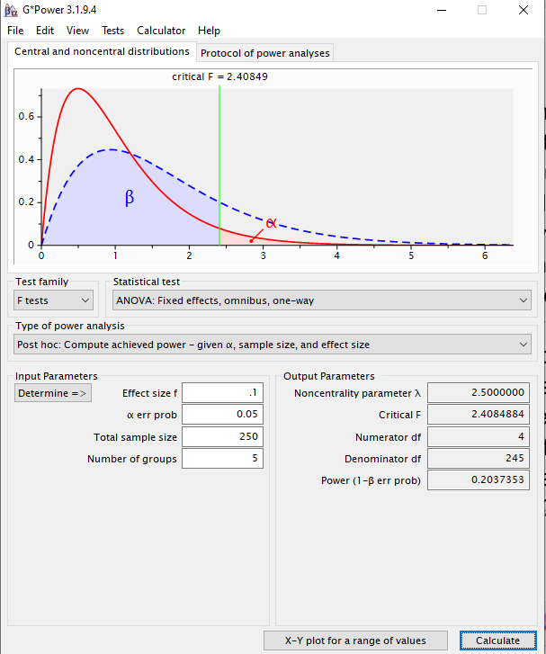
A post-hoc example (Omnibus ANOVA)
Effect size = .10
α = .05
Sample size = 250
Number of groups = 5

Slide 38
A post-hoc example (Omnibus ANOVA)
Your study had power of .204, meaning you only had a 20.4% chance of detecting the effect.
Again, this was extremely underpowered!

Slide 39
In conclusion
Power is the probability you will detect the effect (i.e. a power of .70 means you have a 70% chance of detecting the effect)
Power analyses are essential to any study
Effect size, alpha value, and sample size drive how much power you have
You learned two methods to calculating power:
Murphy, Myors & Wolach (2014) Appendix E
G*Power
*Now do the assignment on Canvas!*

